Slide 1

Telecom Customer Churn Analysis
Uncovering insights from 6,418 customer transactions to reduce churn and drive strategic growth

Slide 2
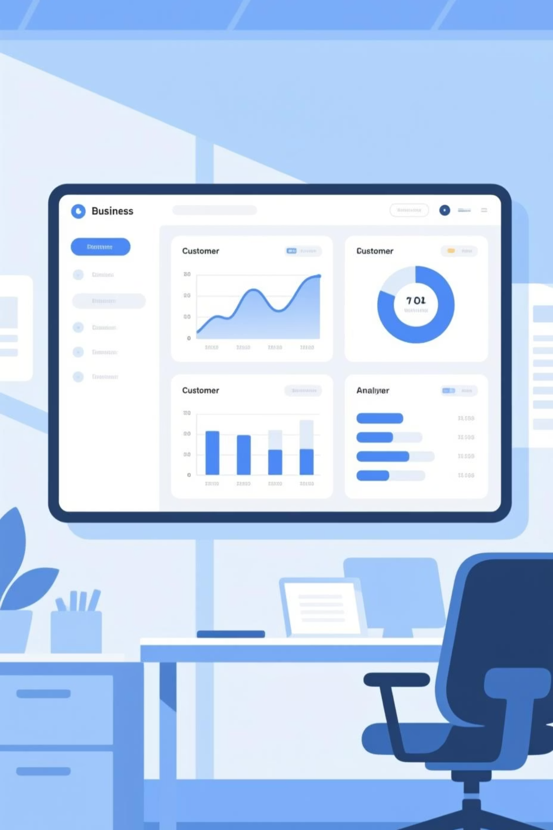
Project Overview
Our Mission
Dataset Scope
Analyze customer churn behavior using comprehensive transactional data to uncover patterns and guide strategic business decisions.
6,418 customer entries
18 key data columns
Demographics, behavior, and churn status

Slide 3

Gender Distribution
Understanding our customer base demographics
50%
50%
Male Customers
Female Customers
Balanced gender representation across customer base
Equal distribution enables targeted strategies

Slide 4
Customer Status Breakdown
Stayed
Churned
New Joiners
Loyal customers who continued their service
Customers who discontinued service
Recently acquired customers
Segmentation reveals critical patterns in customer lifecycle and retention challenges

Slide 5
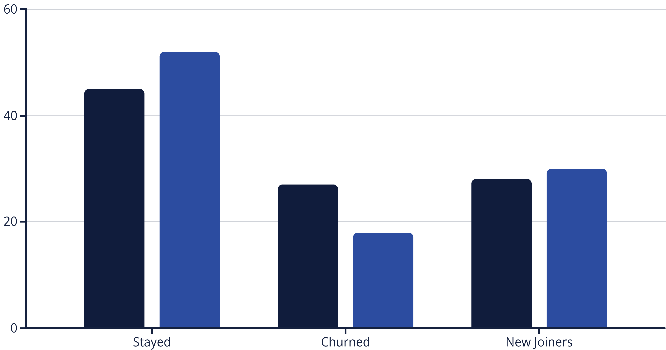
Revenue Impact Analysis
Customer status directly correlates with revenue performance
Customer %
Revenue %
Retained customers generate disproportionately higher revenue, highlighting the critical importance of churn prevention

Slide 6



SQL-Powered Business Intelligence
01
02
Data Extraction
Pattern Analysis
Structured queries in PostgreSQL to access 6,418 customer records
Identified churn behaviors, demographics, and subscription trends
03
Insight Generation
Transformed raw data into actionable business intelligence

Slide 7
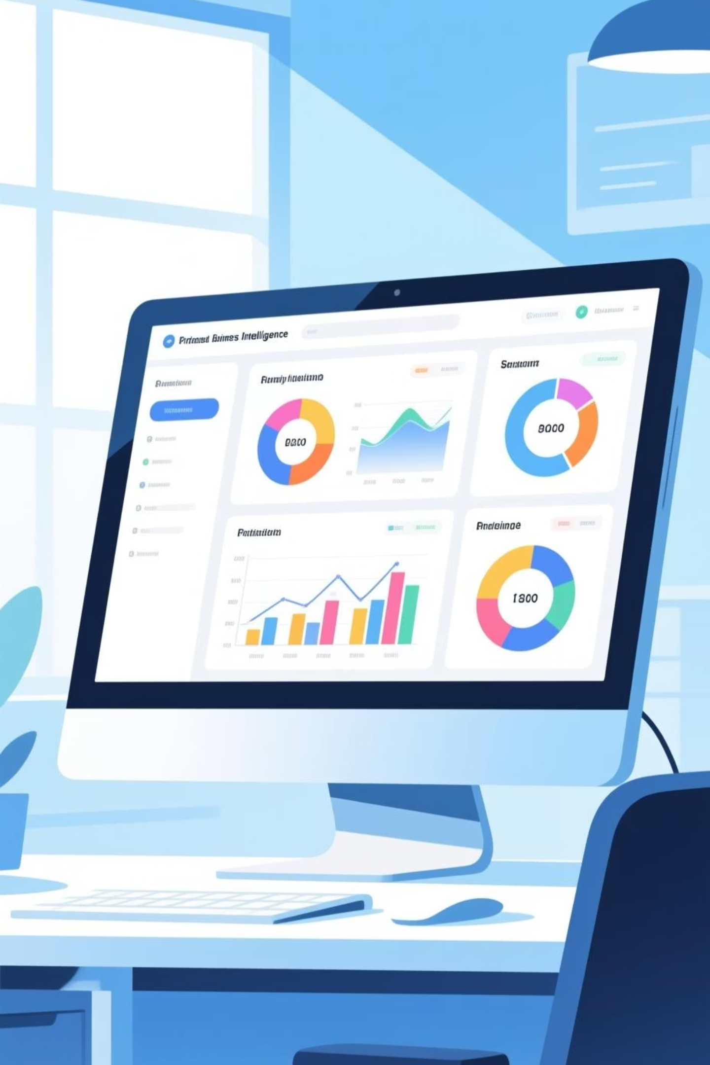
Interactive Power BI Dashboard
Comprehensive visualization bringing data insights to life
Real-Time Metrics
Visual Analytics
Live tracking of churn rates and customer segments
Interactive charts revealing behavioral patterns
Predictive Insights
Machine learning forecasts for new joiners

Slide 8

Machine Learning Predictions
Advanced algorithms forecast churn risk for new customers
Predictive Power
Early Intervention
ML models identify at-risk customers before they churn, enabling proactive retention strategies
Target new joiners with personalized offers based on predicted churn probability

Slide 9
Strategic Recommendations
1
2
Competitive Pricing
Promote Yearly Contracts
Customer feedback reveals competitors offer better deals. Reassess pricing strategy and promotional offers immediately.
Boost long-term commitment with exclusive benefits and incentives for annual subscriptions.
3
4
Reward Loyalty
Focus on 50+ Demographics
Implement rewards program for customers with consecutive year contracts to increase retention.
Majority of churners are above 50. Train support staff on age-appropriate communication and empathy.

Slide 10



Key Takeaway
Churn is preventable. Competitive pricing, enhanced customer service for seniors, and loyalty incentives will significantly reduce attrition and maximize lifetime value.

